Slide 1
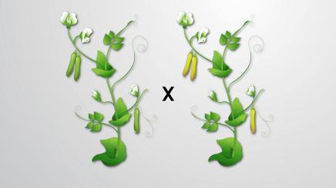
UNIT VII: Genetics
Chapter 2
Classical Genetics

Slide 2
Learning Objectives
The Learner will be able to Differentiate classical and modern genetics.
Understand the concepts of principles of inheritance.
Describe the extensions of Mendelism.
Explain polygenic inheritance and Pleiotropy.
Analyse extra chromosomal inheritance in cytoplasmic organelles.

Slide 3
Chapter outline
  2.1 Heredity and Variation
  2.2 Mendelism
  2.3 Laws of Mendelian Inheritance
  2.4 Monohybrid, Dihybrid, Trihybrid cross, Backcross and Testcross
  2.5 Interaction of Genes -Intragenic and Intergenic Incomplete dominance,
  Lethal genes, Epistasis
  2.6 Polygenic inheritance in Wheat kernel colour, Pleiotropy – Pisum sativum
  2.7 Extra chromosomal inheritance- Cytoplasmic inheritance in Mitochondria
  and Chloroplast.

Slide 4
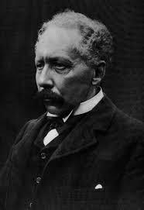
Genetics is the study of how living things receive common traits from previous generations.
Genetics – The Science of heredity (Inheritance) –
“Genetics” is the branch of biological science which deals with the mechanism of transmission of characters from parents to off springs. The term Genetics was introduced by W. Bateson in 1906.

Slide 5
The four major subdisciplines of genetics are
Transmission Genetics / Classical Genetics – Deals with the transmission of genes from parents to off springs.
2. Molecular Genetics – Deals with the structure and function of a gene at
molecular level.
3. Population Genetics – Deals with heredity in groups of individuals for traits
which is determined by a few genes.
4. Quantitative Genetics – Deals with heredity of traits in groups of individuals where the traits are governed by many genes simultaneously.

Slide 6
Heredity and variation
Genetics is often described as a science which deals with heredity and variation.
Heredity: Heredity is the transmission of characters from parents to offsprings.
Variation: The organisms belonging to the same natural population or species that shows a difference in the characteristics is called variation.
Variation is of two types
(i) Discontinuous variation –
Within a population there are some characteristics which show a limited form of variation.
(ii) Continuous variation –
This variation may be due to the combining effects of environmental and genetic factors.

Slide 7
Importance of variations
• Variations make some individuals better fitted in the struggle for existence.
• They help the individuals to adapt themselves to the changing environment.
• It provides the genetic material for natural selection.
• Variations allow breeders to improve better yield, quicker growth, increased resistance and lesser input.
• They constitute the raw materials for evolution.

Slide 8
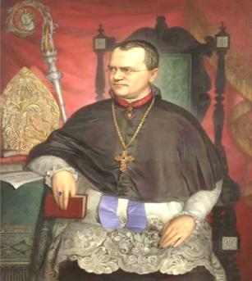
Mendelism
He was born on 22nd July 1822 in Heinzendorf Silesia (now Hyncice, Czechoslovakia), Austria.
In 1849 Mendel was working as a school teacher and he
performed his experiments with pea plants.
Mendel discovered the principles of heredity by studying
the inheritance of seven pairs of contrasting traits of pea
plant in his garden.
Mendel crossed and catalogued 24,034 plants through many
generations. His paper entitled “Experiments on Plant Hybrids”
was presented and published in The Proceedings of the
Brunn Society of Natural History in 1866.
Mendel - Father of Genetics.

Slide 9
Mendel was successful because:
• He applied mathematics and statistical methods to biology and laws of probability to his breeding experiments.
• He followed scientific methods and kept accurate and detailed records that include quantitative data of the outcome of his crosses.
• His experiments were carefully planned and he used large samples.
• The pairs of contrasting characters which were controlled by factor (genes)were present on separate chromosomes.
• The parents selected by Mendel were pure breed lines and the purity was tested by self crossing the progeny for many generations.

Slide 10
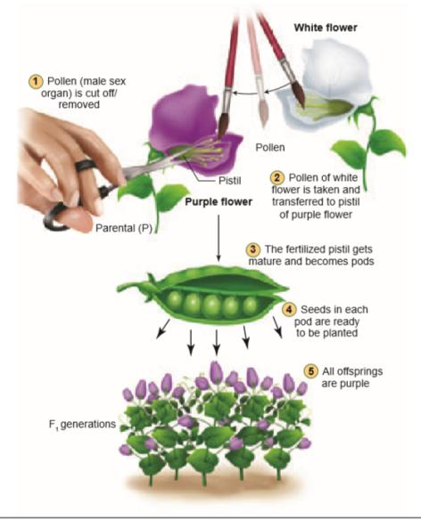
Steps
in
cross pollination of pea flowers

Slide 11
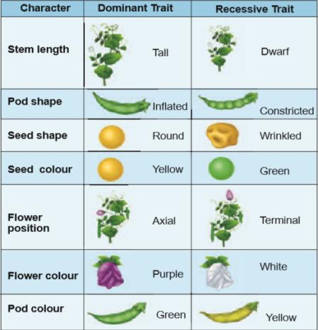
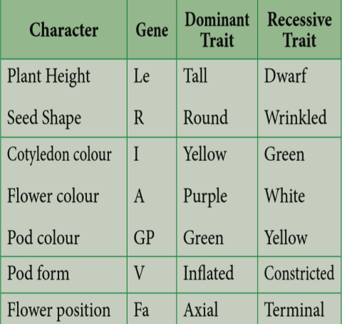
The First Model Organism in Genetics – Garden Peas (Pisum sativum)
Seven characters studied by Mendel
Seven characters of Pisum sativum with genes

Slide 12
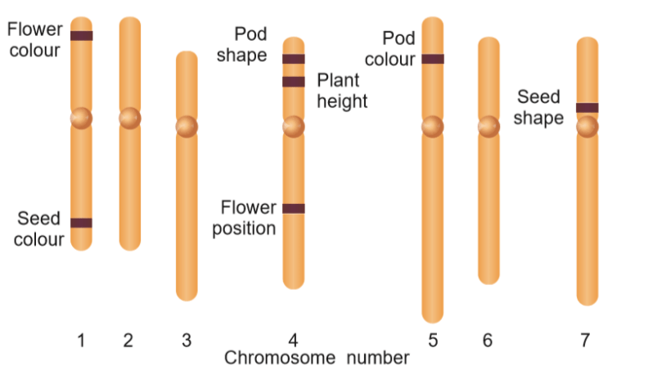
Mendel’s seven characters in Garden Peas, shown on the plant’s seven chromosomes

Slide 13
Terminology related to Mendelism
Alleles : alternate forms (versions) for the same trait.
Homozygous(TT): two identical alleles of a gene in an individual.
Heterozygous(Tt): an individual with two different alleles.
Hybrids : Mendel’s non-true breeding plants

Slide 14
Mendelian inheritance – Mendel’s Laws of Heredity
The first law is The Law of Dominance
The second law is The Law of Segregation (Law of Purity of gametes)
Today these rules are called laws of inheritance

Slide 15
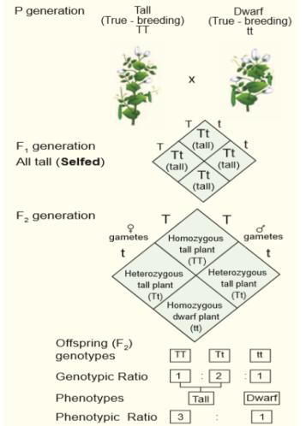
Monohybrid cross
Reciprocal cross –
The tall pea plants were pollinated with the pollens from a true-breeding dwarf plants, the result was all tall plants. When the parental types were reversed, the pollen from a tall plant was used to pollinate a dwarf pea plant which gave only tall plants. The result was the same - All tall plants

Slide 16
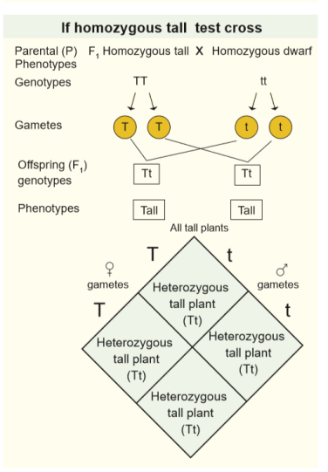
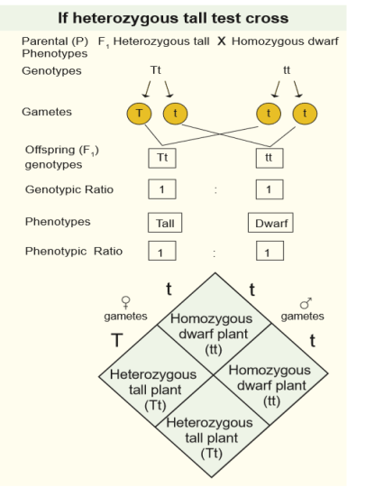
Test cross

Slide 17
Back cross
• Back cross is a cross of F1 hybrid with any one of the parental genotypes.
The back cross is of two types:
  Dominant back cross
  Recessive back cross

Slide 18
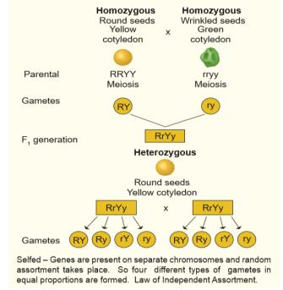
Dihybrid cross
It involves individuals differing in two characters. Dihybrid inheritance is the inheritance of two separate genes each with two alleles.
Law of Independent Assortment
Dihybrid cross – Segregation of gametes

Slide 19
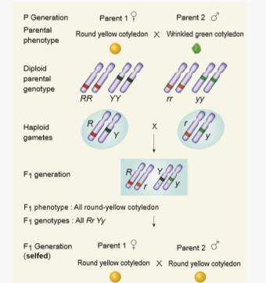
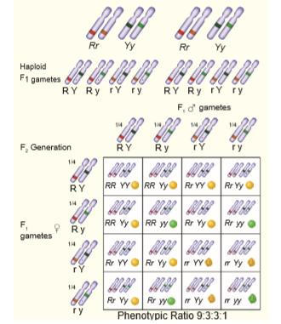
Dihybrid Cross in Garden peas

Slide 20
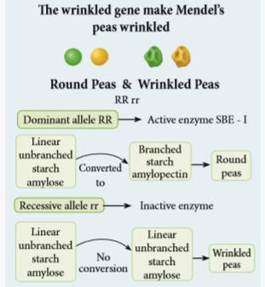
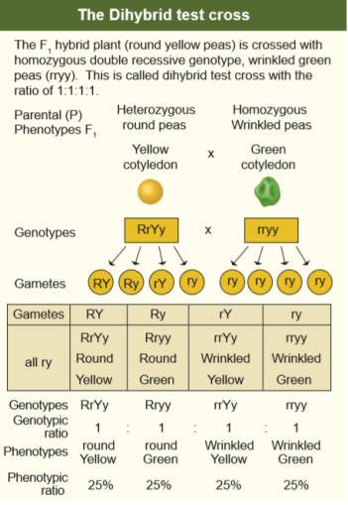
Molecular explanation of round and wrinkled peas

Slide 21
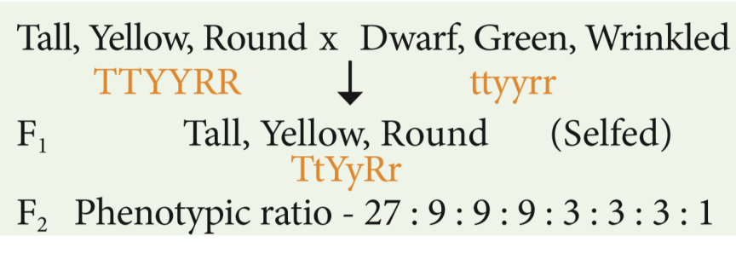
Trihybrid cross
A cross between homozygous parents that differ in three gene pairs (i.e. producing trihybrids) is called trihybrid cross.
The three contrasting characters of a trihybrid cross are

Slide 22
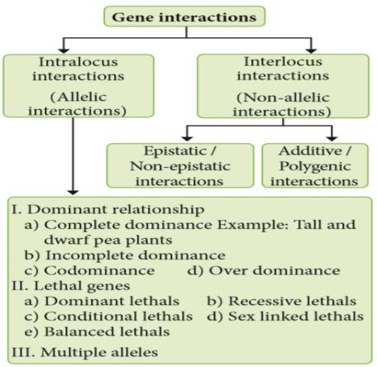
Extensions of Mendelian Genetics
Gene interaction – A single phenotype is controlled by more than one set of genes, each of which has two or more alleles.
The gene interactions can be classified as
• Intragenic gene interactions or Intra allelic or allelic interactions
• Intergenic gene interactions or inter allelic or non-allelic interactions

Slide 23
Intragenic gene interactions
Interactions take place between the alleles of the same gene i.e., alleles at the same locus is called intragenic or intralocus gene interaction.
It includes the following:
  1)Incomplete dominance
  2) Codominance
  3)Multiple alleles
  4) Pleiotropic genes

Slide 24
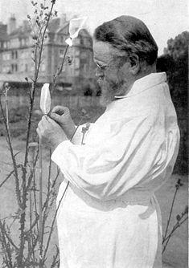
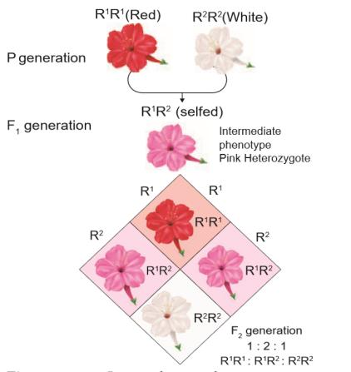
Incomplete dominance – No blending of genes
The German Botanist Carl Correns’s (1905) Experiment - In 4 O’ clock plant, Mirabilis jalapa
Codominance (1 : 2 : 1)
This pattern occurs due to simultaneous (joint) expression of both alleles in the heterozygote.
The codominance was demonstrated in plants with the help of electrophoresis or chromatography for protein or flavonoid substance. Example: Gossypium hirsutum and Gossypium sturtianum,
Carl Correns

Slide 25
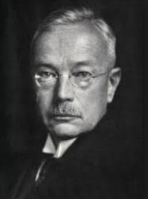
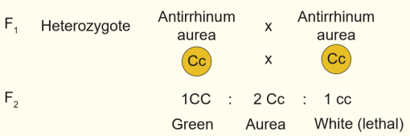
Lethal genes
An allele which has the potential to cause the death of an organism is called a “Lethal Allele”.
In 1907, E. Baur reported a lethal gene in snapdragon (Antirrhinum sp.). It is an example for recessive lethality.
In snapdragon there are three kinds of plants.
Green plants with chlorophyll. (CC)
Yellowish green plants with carotenoids are referred to as pale green, golden or aurea plants (Cc)
White plants without any chlorophyll. (cc)
  The genotype of the homozygous green plants is CC.
  The genotype of the homozygous white plant is cc.
Erwin Baur

Slide 26
Pleiotropy – A single gene affects multiple traits
“Pleiotropie" was first coined by Ludwig Plate
Hans Grüneberg was the first to study the mechanisms of pleiotropy
The Pleiotropic gene influences a number of characters simultaneously.
Mendel noticed pleiotropy while performing breeding experiment with peas (Pisum sativum).
Example: sickle cell anemia.

Slide 27
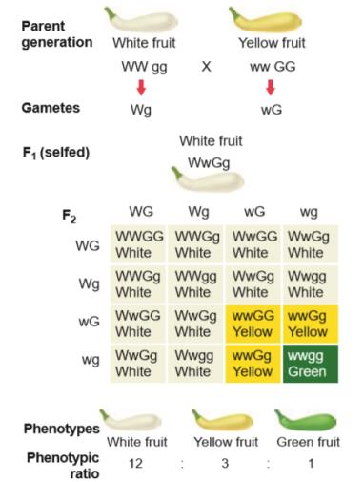
Dominant epistasis in summer squash
Intergenic gene interactions
Interlocus interactions take place between the alleles at different loci i.e between alleles of different genes.

Slide 28
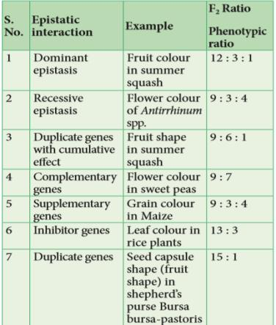
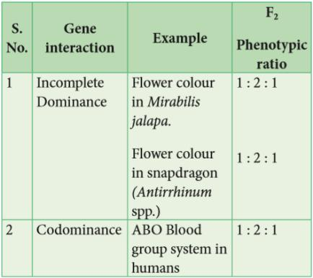
Intra- genic interaction
Inter-genic interaction

Slide 29
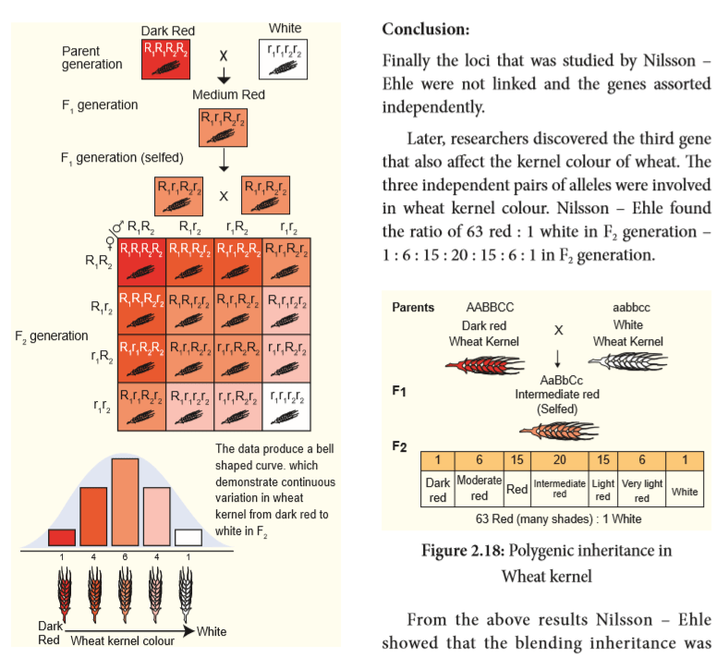
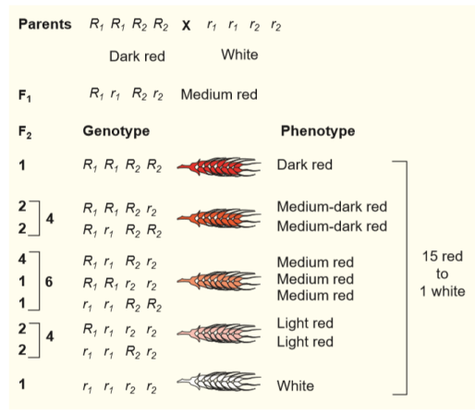
Polygenic Inheritance in Wheat (Kernel colour)
The genetic control of colour in wheat kernels

Slide 30
Polygenic inheritance in Wheat kernel

Slide 31
THANK YOU

